Slide 1
Customer Relationship Management
By: Torsten Marsh, Kole Peterson,Emmanuella Shokare,Viacheslav Sotov, Devon McKinney

Slide 2
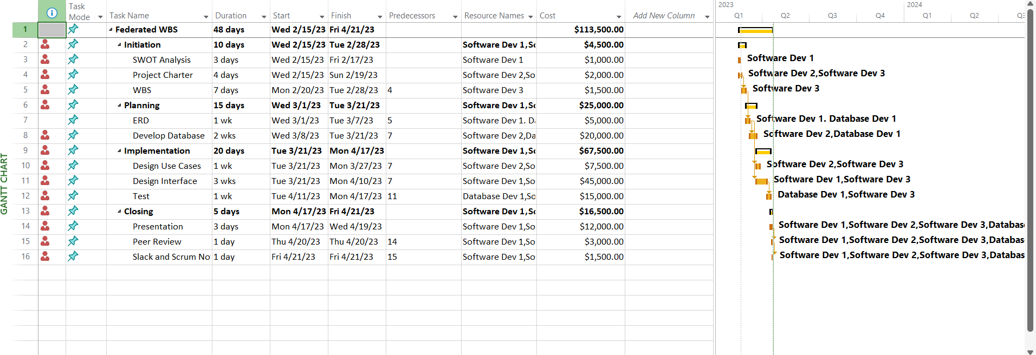
Work Breakdown Structure and Gantt Chart

Slide 3
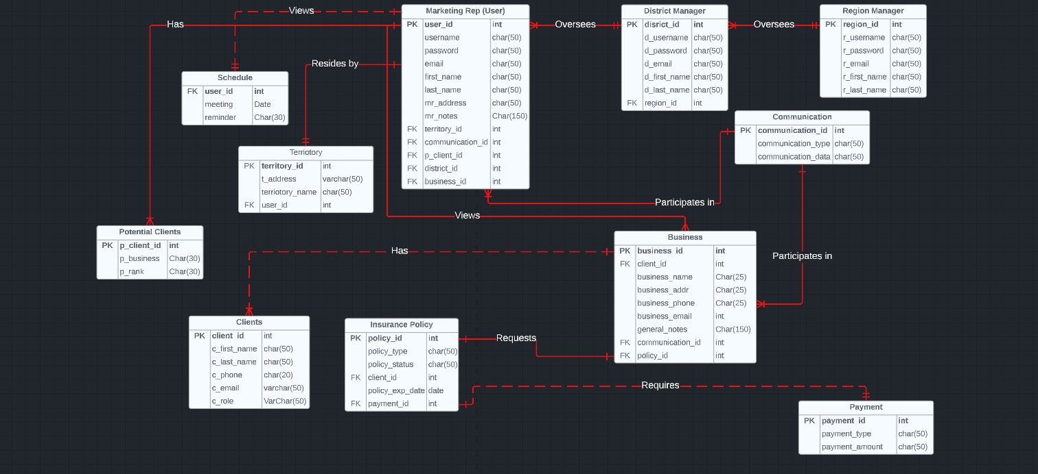
Entity Relationship Diagram

Slide 4
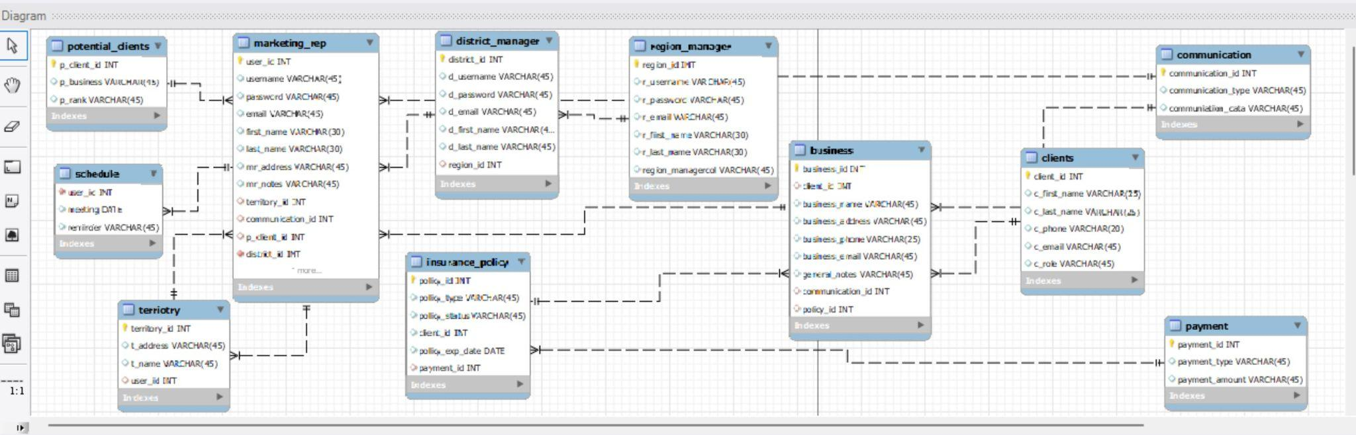
Database Relationships

Slide 5
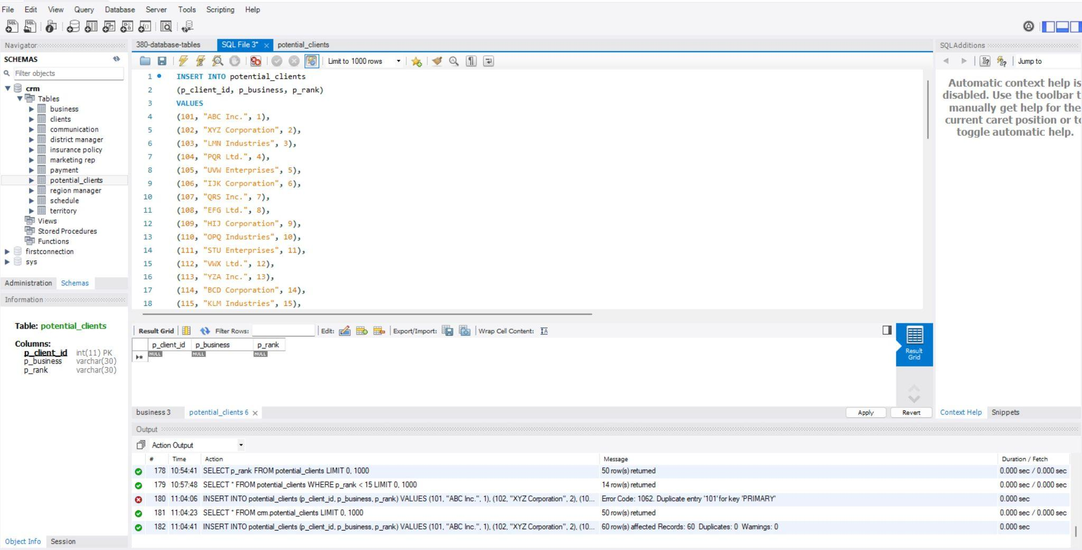
Database Insert Potential Clients Data

Slide 6
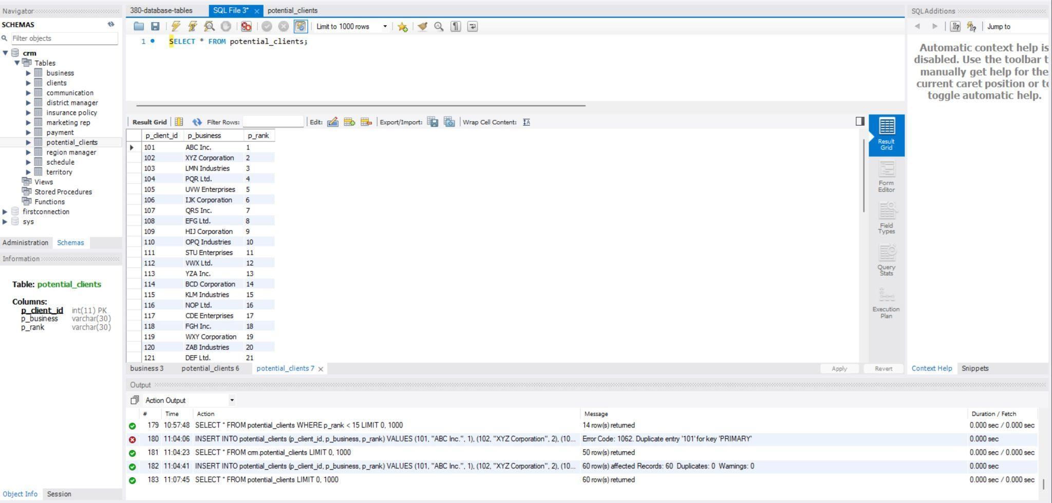
Database Potential Clients Data

Slide 7
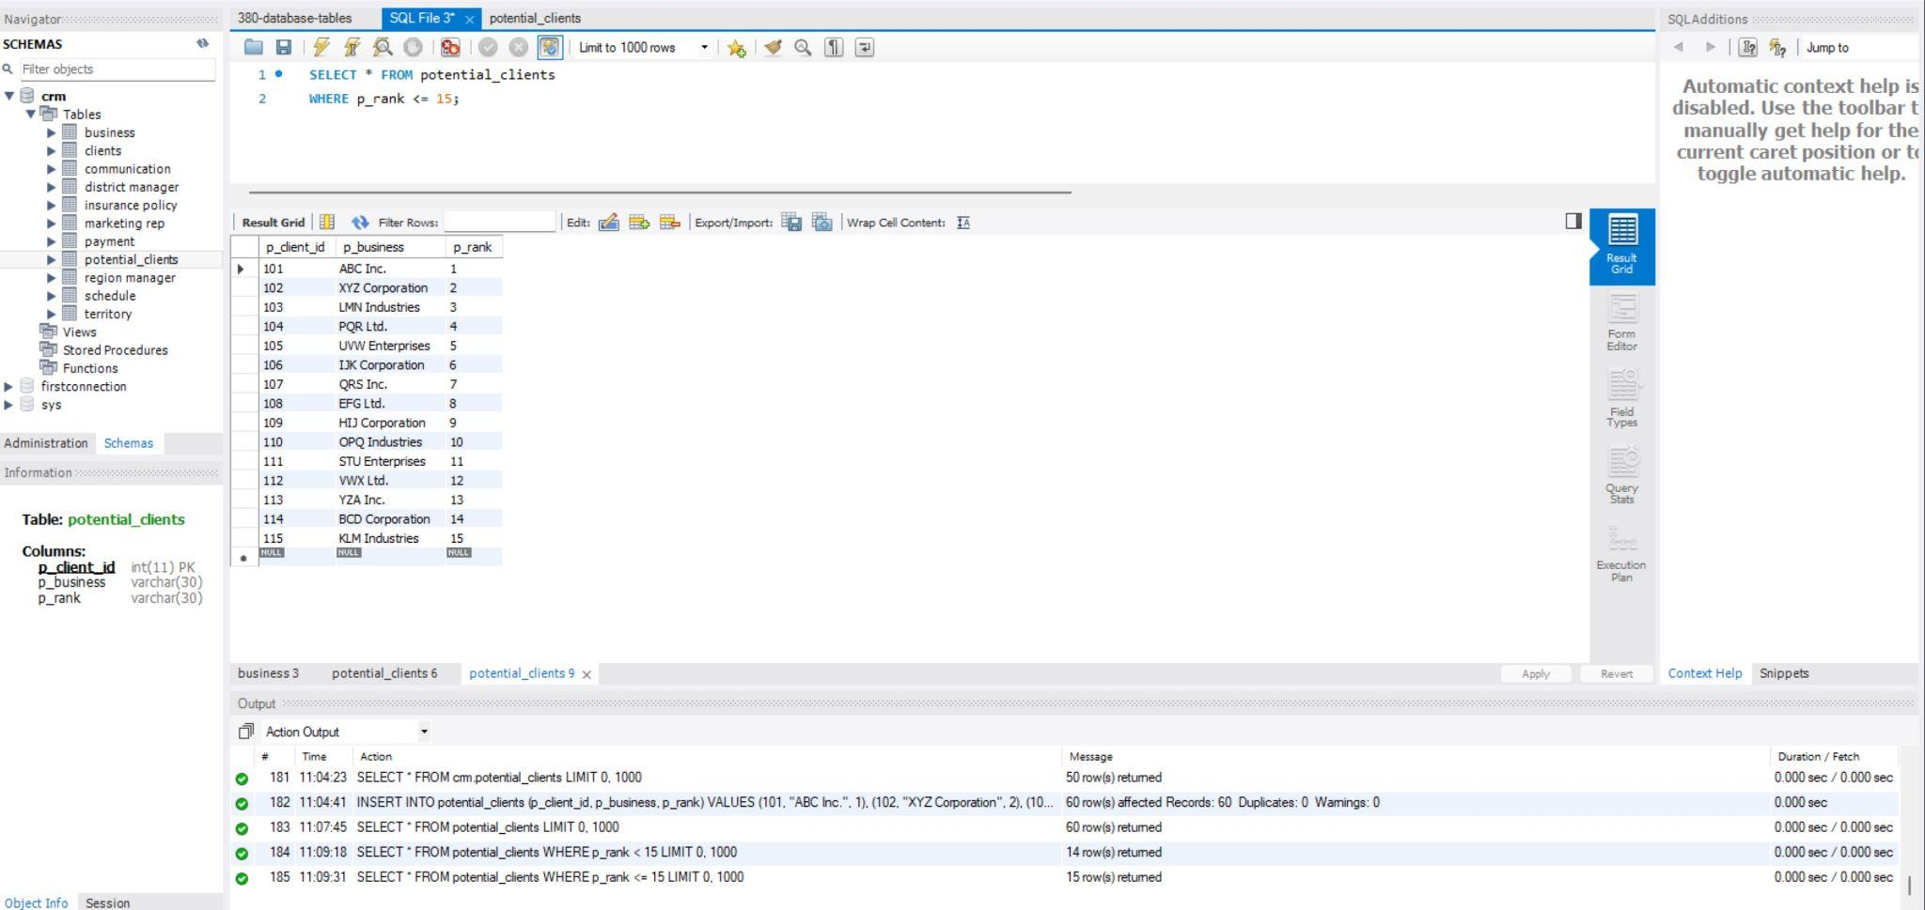
Database Query: Top 15

Slide 8
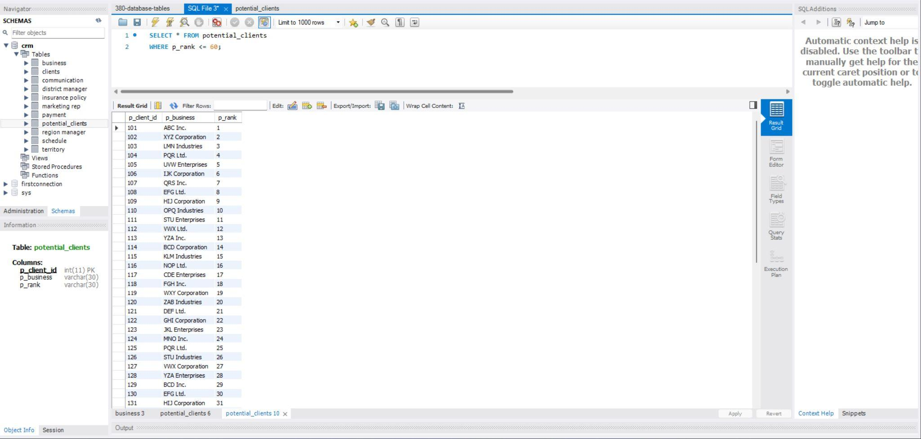
Database Query: Top 60

Slide 9
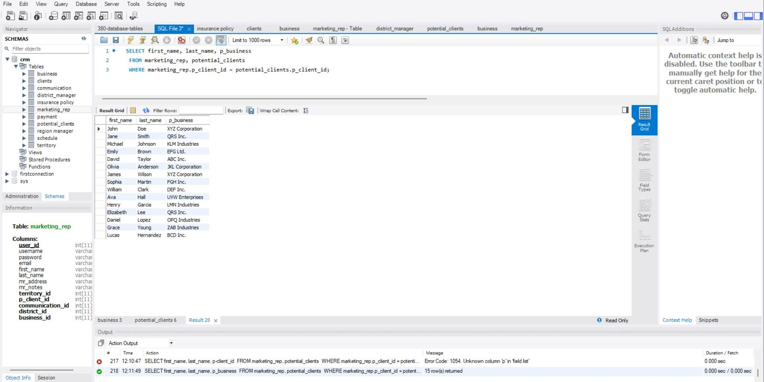
Database Query: What potential business is overseen by which Marketing Rep

Slide 10
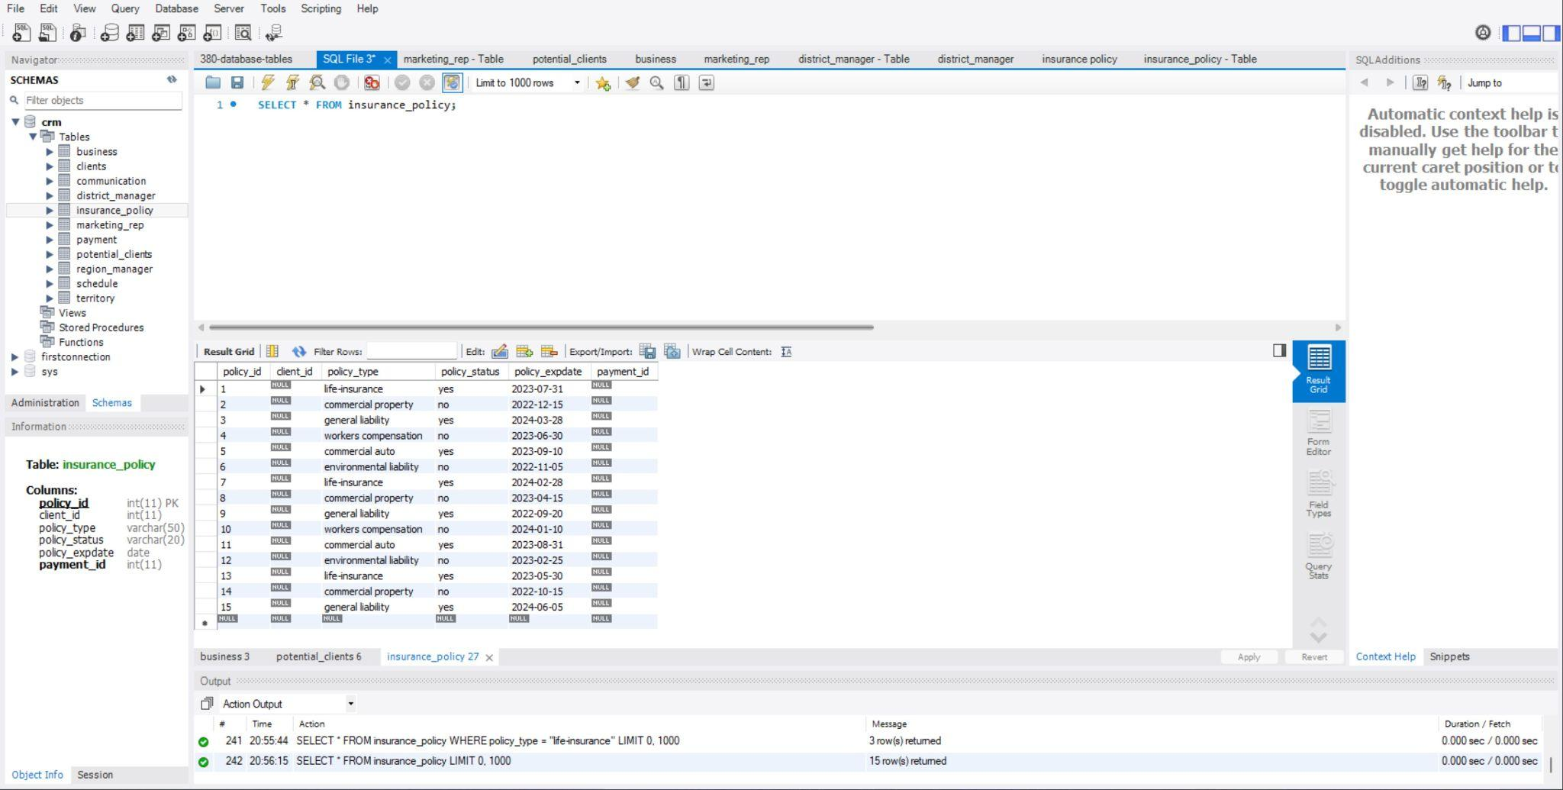
Database Query: All active Insurance Policies

Slide 11
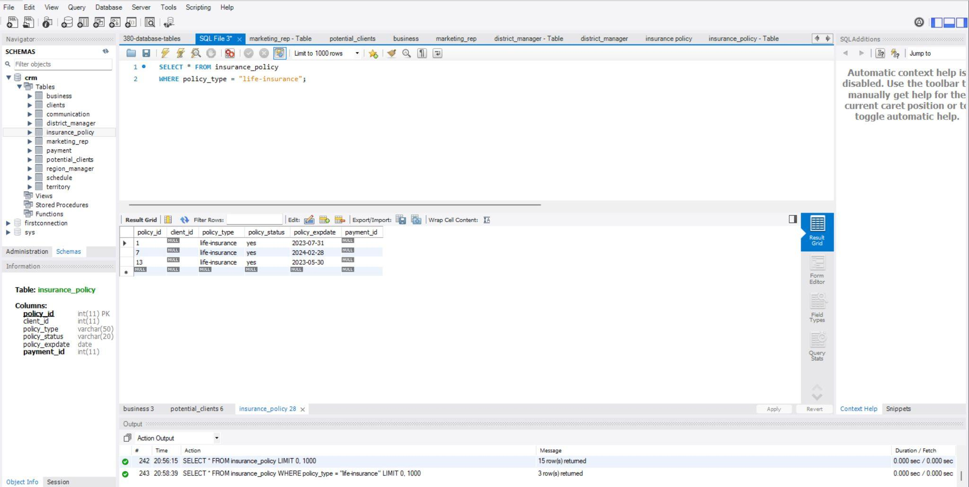
Database Query: Life Insureds

Slide 12
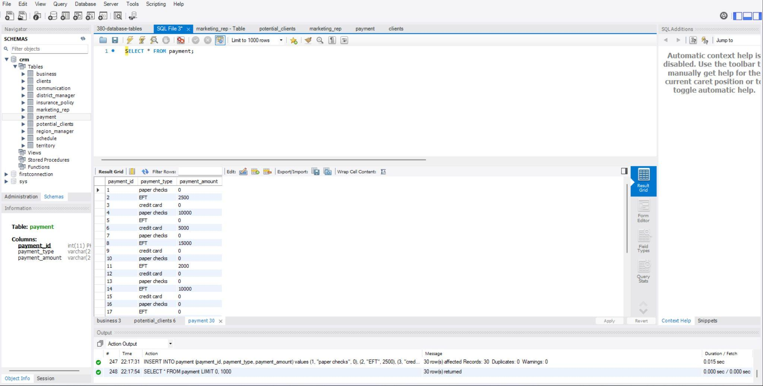
Database Query: All payments for insurance

Slide 13
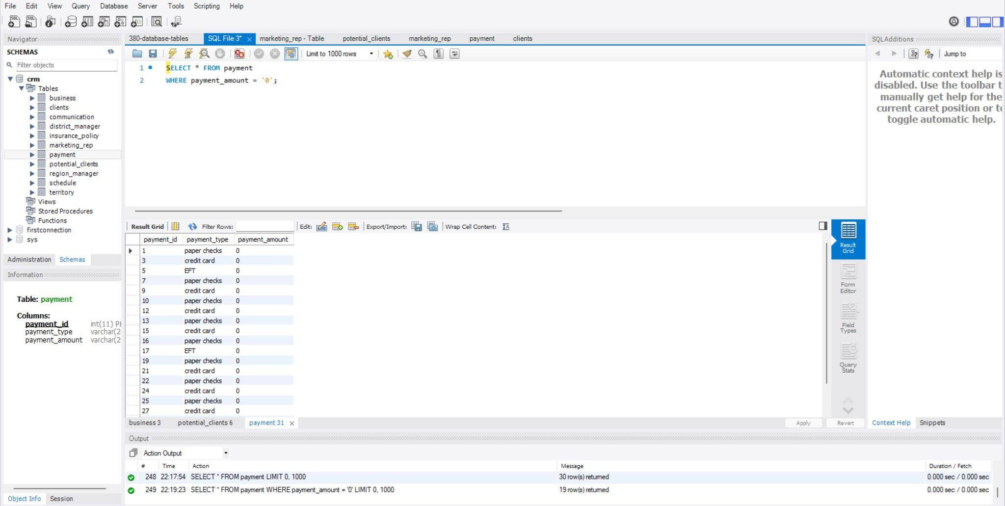
Database Query: Unpaid Insurance Policies

Slide 14
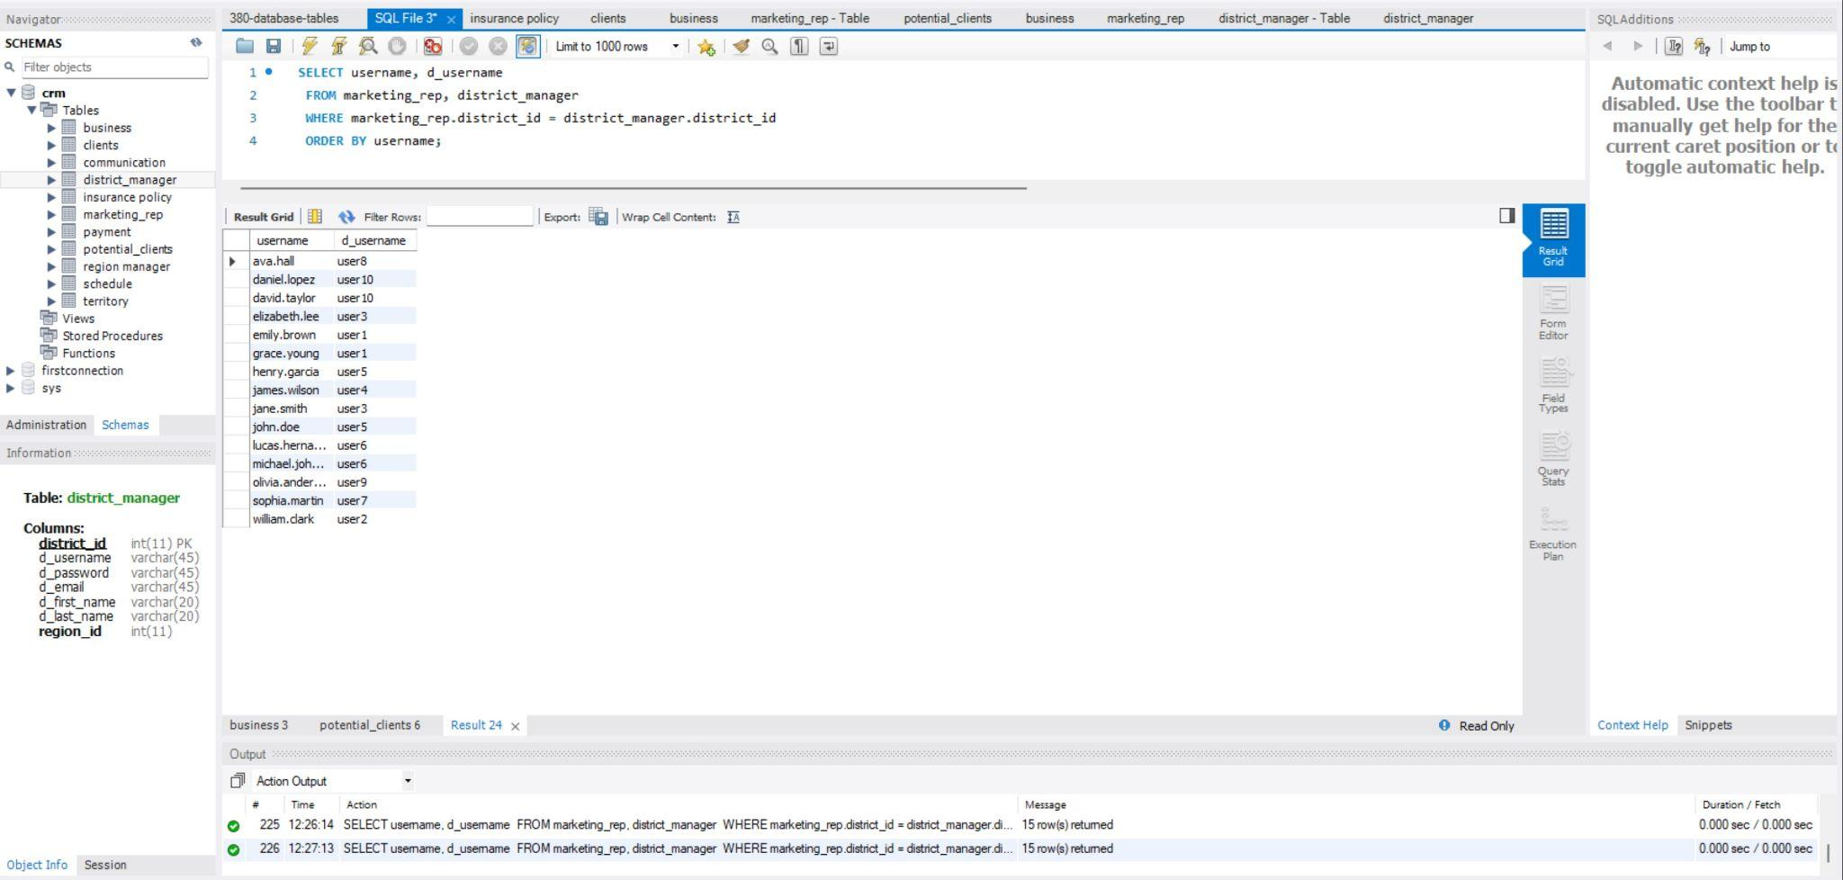
Database Query: District Manager oversees Marketing Rep

Slide 15
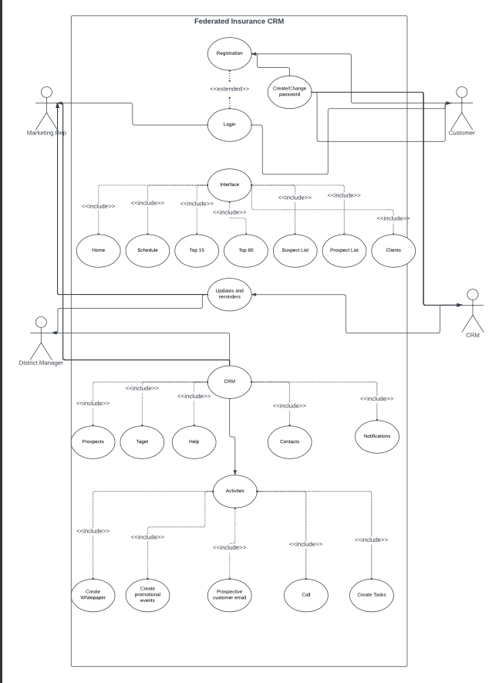
Use Cases

Slide 16

User Interface (Demo)

Slide 17

Thanks for listening!

